Slide 1
CHAPTER 1
RELATIONAL DATABASES

Slide 2
INTRODUCTION
27/05
Database systems are designed to manage large bodies of information. Management of data involves both defining structures for storage of information and providing mechanisms for the manipulation of information.
In addition, the database system must ensure the safety of the information stored, despite system crashes or attempts at unauthorized access. If data are to be shared among several users, the system must avoid possible anomalous results.
What is a A Database-Management System (DBMS) ?
Software/Hardware ???
DBMS is a Software
Collection of interrelated data
A set of programs to access those data.
The collection of data, usually referred to as the database, contains information relevant to an enterprise.
The primary goal of a DBMS is to provide a way to store and retrieve database information that is both convenient and efficient.

Slide 3
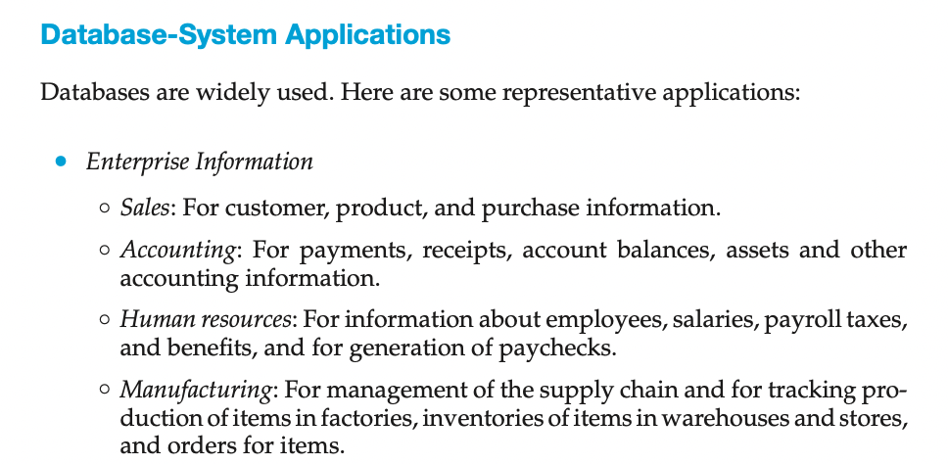

Slide 4
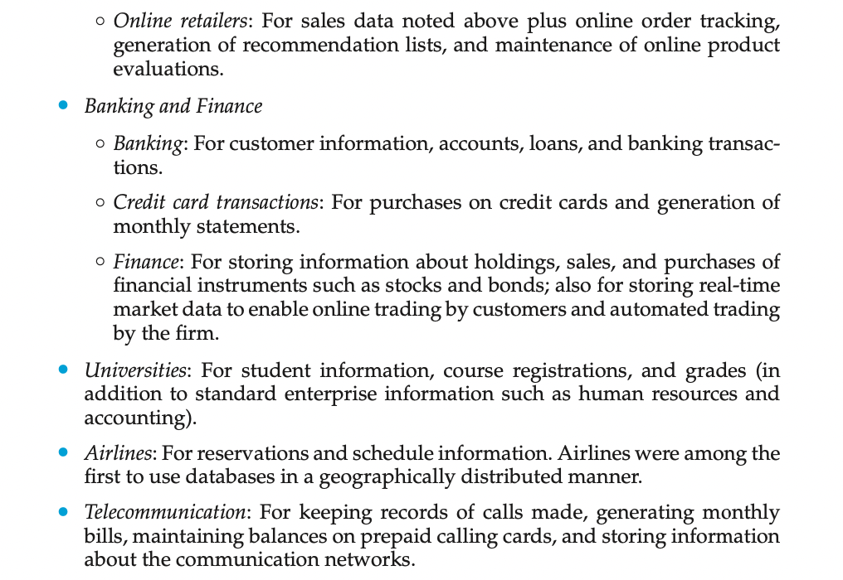

Slide 5
Traditional/Conventional System
Before the Invention of DBMS---
file-processing system - supported by a conventional operating system.
The system stores permanent records in various files, and it needs different application programs to extract records from, and add records to, the appropriate files.
Before database management systems (DBMSs) were introduced, organizations usually stored information in such systems.

Slide 6
Purpose of Database Management System
Data redundancy and inconsistency: Since different programmers create the files and application programs over a long period, the various files are likely to have different structures and the programs may be written in several programming languages. Moreover, the same information may be duplicated in several places (files).
For example, if a student has a double major (say, music and mathematics) the address and telephone number of that student may appear in a file that consists of student records of students in the Music department and in a file that consists of student records of students in the Mathematics department. This redundancy leads to higher storage and access cost.
Data inconsistency : The various copies of the same data may no longer agree. For example, a changed student address may be reflected in the Music department records but not elsewhere in the system.
2. Difficulty in accessing data. Suppose that one of the university clerks needs to find out the names of all students who live within a particular postal-code area. The clerk asks the data-processing department to generate such a list. Because the designers of the original system did not anticipate this request, there is no application program on hand to meet it. There is, however, an application program to generate the list of all students. The university clerk has now two choices: either obtain the list of all students and extract the needed information manually or ask a programmer to write the necessary application program. Both alternatives are obviously unsatisfactory. Suppose that such a program is written, and that, several days later, the same clerk needs to trim that list to include only those students who have taken at least 60 credit hours. As expected, a program to generate such a list does not exist. Again, the clerk has the preceding two options, neither of which is satisfactory. The point here is that conventional file-processing environments do not allow needed data to be retrieved in a convenient and efficient m

Slide 7
Contd..
6. Atomicity problems. A computer system, like any other device, is subject to failure. In many applications, it is crucial that, if a failure occurs, the data be restored to the consistent state that existed prior to the failure. Consider a program to transfer $500 from the account balance of department A to the account balance of department B. If a system failure occurs during the execution of the program, it is possible that the $500 was removed from the balance of department A but was not credited to the balance of department B, resulting in an inconsistent database state. Clearly, it is essential to database consistency that either both the credit and debit occur, or that neither occur. That is, the funds transfer must be atomic—it must happen in its entirety or not at all. It is difficult to ensure atomicity in a conventional file-processing system.
7. Concurrent-access-anomalies : Consider department A, with an account balance of $10,000. If two department clerks debit the account balance (by say $500 and $100, re- spectively) of department A at almost exactly the same time, the result of the concurrent executions may leave the budget in an incorrect (or inconsistent) state. Suppose that the programs executing on behalf of each withdrawal read the old balance, reduce that value by the amount being withdrawn, and write the result back. If the two programs run concurrently, they may both read the value $10,000, and write back $9500 and $9900, respectively. Depending on which one writes the value last, the account balance of department A may contain either $9500 or $9900, rather than the correct value of $9400.
3. Data isolation. Because data are scattered in various files, and files may be in different formats, writing new application programs to retrieve the appropriate data is difficult.
4. Integrity problems. The data values stored in the database must satisfy certain types of consistency constraints. Suppose the university maintains an account for each department, and records the balance amount in each account. Suppose also that the university requires that the account balance of a department may never fall below zero. Developers enforce these constraints in the system by adding appropriate code in the various application programs. However, when new constraints are added, it is difficult to change the programs to enforce them. The problem is compounded when constraints involve several data items from different files.
5. Security problems. Not every user of the database system should be able to access all the data. For example, in a university, payroll personnel need to see only that part of the database that has financial information. They do not need access to information about academic records. But, since applica- tion programs are added to the file-processing system in an ad hoc manner, enforcing such security constraints is difficult.

Slide 8
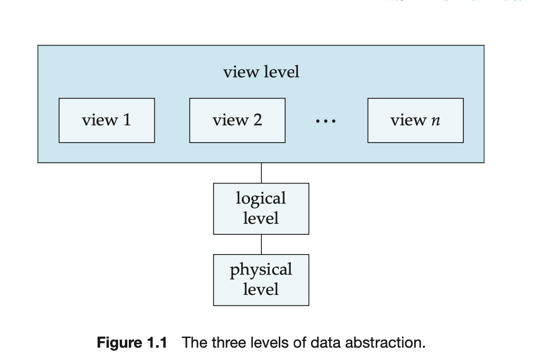
View of Data
A database system is a collection of interrelated data and a set of programs that allow users to access and modify these data.
Abstraction of Data : The system hides certain details of how the data are stored and maintained.
Physical Level :The lowest level of abstraction describes how the data are actually stored. The physical level describes complex low-level data structures in detail.
Logical Level : describes what data are stored in the database, and what relationships exist among those data. The logical level thus describes the entire database in terms of a small number of relatively simple structures. Although implementation of the simple struc- tures at the logical level may involve complex physical-level structures, the user of the logical level does not need to be aware of this complexity. This is referred to as physical data independence. Database administrators, who must decide what information to keep in the database, use the logical level of abstraction.
View level : Even though the logical level uses simpler structures, complexity remains because of the variety of information stored in a large database. Many users of the database system do not need all this information; instead, they need to access only a part of the database. The view level of abstraction exists to simplify their interaction with the system. The system may provide many views for the same database.

Slide 9
Instance & Schema
28/05
The logical schema is the most important, in terms of its effect on application programs, since programmers construct applications by using the logical schema. T
he physical schema is hidden beneath the logical schema, and can usually be changed easily without affecting application programs. Application programs are said to exhibit physical data independence if they do not depend on the physical schema, and thus need not be rewritten if the physical schema changes.
The collection of information stored in the database at a particular moment is called an instance of the database.
The overall design of the database is called the database schema.
The (i) physical schema describes the database design at the physical level, while the (2) logical schema describes the database design at the logical level.
A database may also have several schemas at the view level, sometimes called (3)subschemas, that describe different views of the database.

Slide 10
Data Model
3. Object oriented Model
Object-oriented data model that can be seen as extending the E-R model with notions of encapsulation, methods (functions), and object identity. The object-relational data model combines features of the object-oriented data model and relational data model.
4. Semistructured Data Model. The semistructured data model permits the specification of data where individual data items of the same type may have different sets of attributes. This is in contrast to the data models mentioned earlier, where every data item of a particular type must have the same set of attributes. The Extensible Markup Language (XML) is widely used to represent semistructured data.
The network data model and the hierarchical data model pre- ceded the relational data model
A collection of conceptual tools for describing data, data relationships, data semantics, and consistency constraints.
A data model provides a way to describe the design of a database at the physical, logical, and view levels.
Relational Model. The relational model uses a collection of tables to represent both data and the relationships among those data. Each table has multiple columns, and each column has a unique name. Tables are also known as relations.The relational model is an example of a record-based model.
2. Entity-Relationship Model.
uses a collection of basic objects, called entities, and relationships
among these objects. An entity is a “thing” or “object” in the real
world that is distinguishable from other objects.

Slide 11
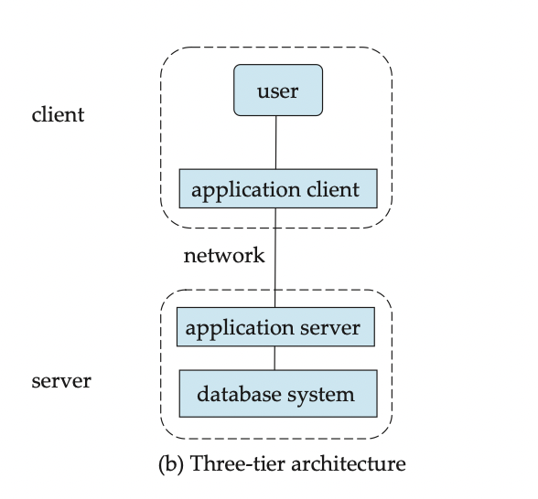
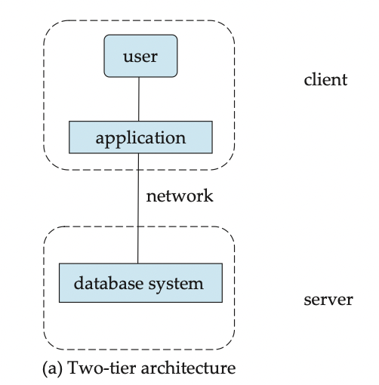
Database Architecture
In a three-tier architecture, the client machine acts as merely a front end and does not contain any direct database calls. Instead, the client end communicates with an application server, usually through a forms interface. The application server in turn communicates with a database system to access data. The business logic of the application, which says what actions to carry out under what conditions, is embedded in the application server, instead of being distributed across multiple clients. Three-tier applications are more appropriate for large applications, and for applications that run on the World Wide Web.
In a two-tier architecture, the application resides at the client machine, where it invokes database system functionality at the server machine through query language statements.
Application program interface standards like ODBC and JDBC are used for interaction between the client and the server.

Slide 12
Database Users and User Interfaces
There are four different types of database-system users, differentiated by the way they expect to interact with the system.
Na ̈ıve users are unsophisticated users who interact with the system by invoking one of the application programs. Example: Consider a student, who during class registration period, wishes to register for a class by using a Web interface. Such a user connects to a Web application program that runs at a Web server. The appli- cation first verifies the identity of the user, and allows her to access a form where she enters the desired information. The form information is sent back to the Web application at the server, which then determines if there is room in the class (by retrieving information from the database) and if so adds the student information to the class roster in the database.
Application programmers are computer professionals who write application programs. Application programmers can choose from many tools to develop user interfaces. Rapid application development (RAD) tools are tools that enable an application programmer to construct forms and reports with minimal programming effort.
Sophisticated users interact with the system without writing programs. Instead, they form their requests either using a database query language or by using tools such as data analysis software. Analysts who submit queries to explore data in the database fall in this category.
Specialized users are sophisticated users who write specialized database applications that do not fit into the traditional data-processing framework. Among these applications are computer-aided design systems, knowledge- base and expert systems, systems that store data with complex data types (for example, graphics data and audio data), and environment-modeling systems.

Slide 13
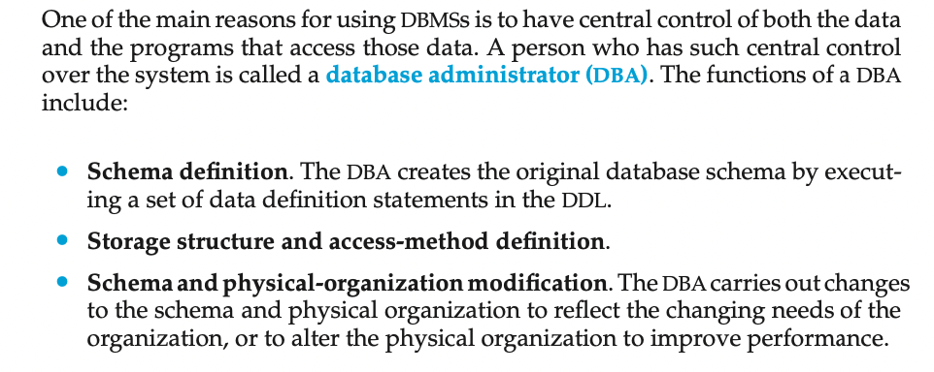
Database Administrator

Slide 14
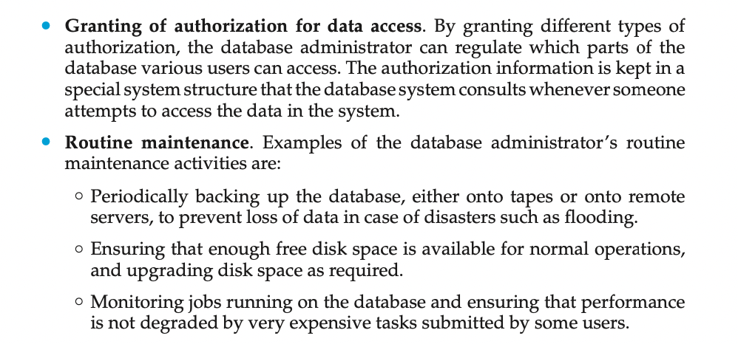

Slide 15
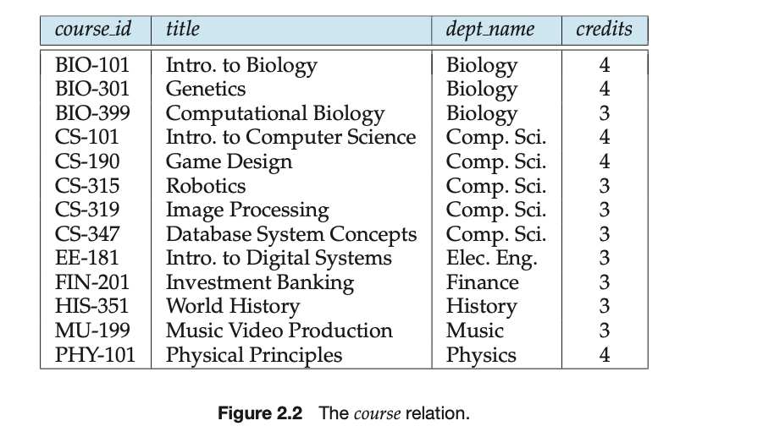
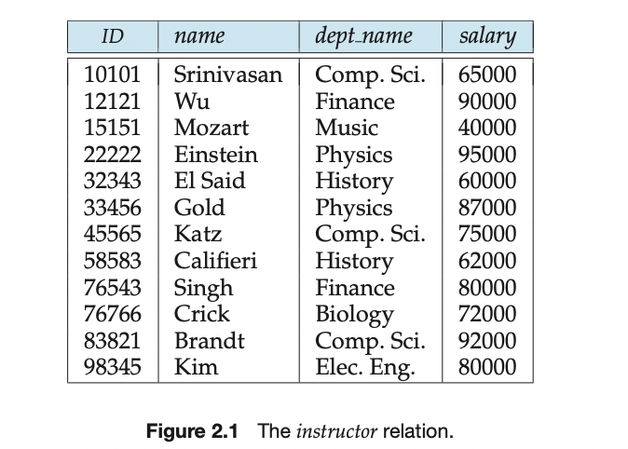
Relational Database
31/05/2021
In the relational model the term relation is used to refer to a table, while the term tuple is used to refer to a row. Similarly, the term attribute refers to a column of a table.
Relation instance to refer to a specific instance of a relation,i.e., containing a specific set of rows. The instance of instructor shown in Figure, it has 12 tuples, corresponding to 12 instructors.
Structure of Relational Databases
A relational database consists of a collection of tables, each of which is assigned a unique name. For example, consider the instructor table
A row in a table represents a relationship among a set of values.
Since a table is a collection of such relationships, there is a close correspondence between the concept of table and the mathematical concept of relation, from which the relational data model takes its name

Slide 16
Domain, Atomic Domain Value, Null Values
For each attribute of a relation, there is a set of permitted values, called the domain of that attribute. Thus, the domain of the salary attribute of the instructor relation is the set of all possible salary values, while the domain of the name attribute is the set of all possible instructor names.
We require that, for all relations r, the domains of all attributes of r be atomic. A domain is atomic if elements of the domain are considered to be indivisible units. For example, suppose the table instructor had an attribute phone number, which can store a set of phone numbers corresponding to the instructor. Then the domain of phone set of phone numbers, and it has subparts, namely the individual phone numbers in the set.number would not be atomic, since an element of the domain is a
The null value is a special value that signifies that the value is unknown or does not exist. For example, suppose as before that we include the attribute phone number in the instructor relation. It may be that an instructor does not have a phone number at all, or that the telephone number is unlisted. We would then have to use the null value to signify that the value is unknown or does not exist.

Slide 17
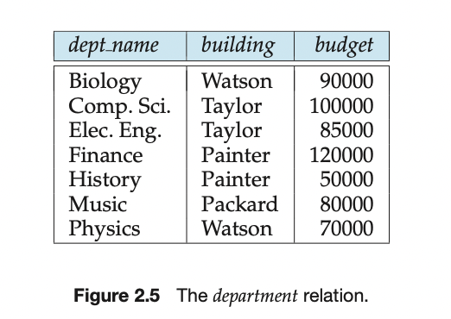
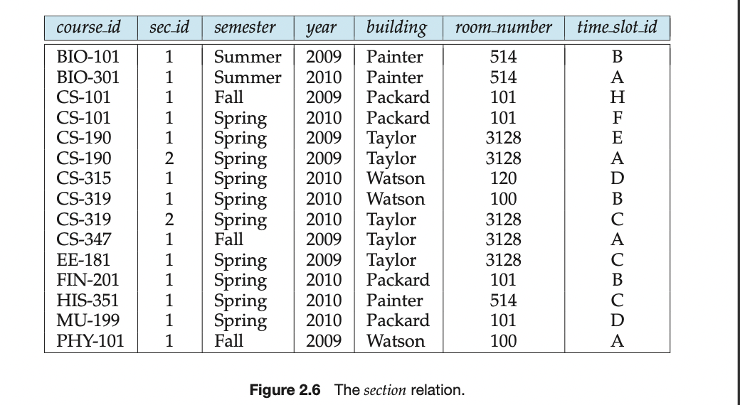
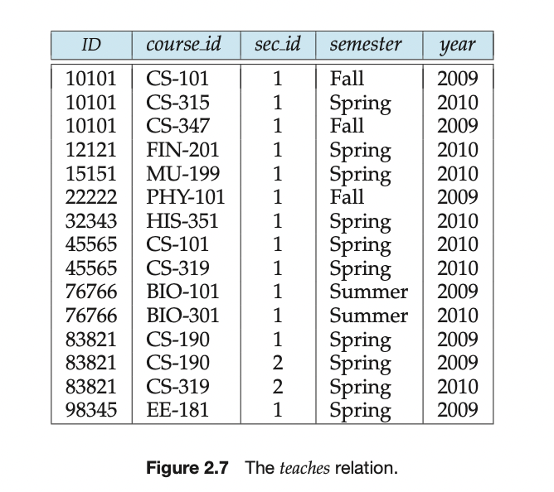
Database schema, is the logical design of the database, and the
Database instance, is a snapshot of the data in the database at a given instant in time.
A relation schema consists of a list of attributes and their corresponding domains.
A relation instance to refer to a specific instance of a relation,i.e., containing a specific set of rows.

Slide 18
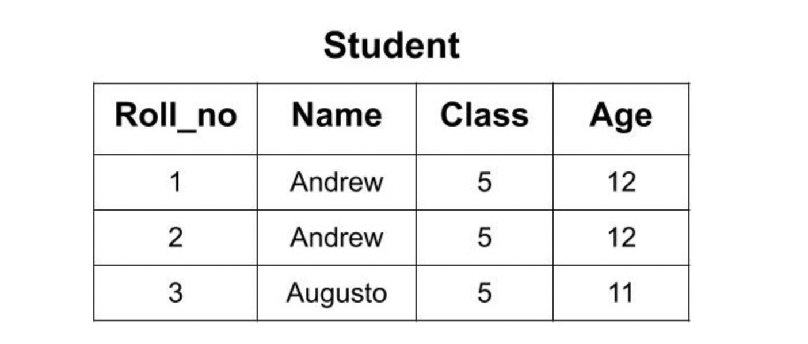
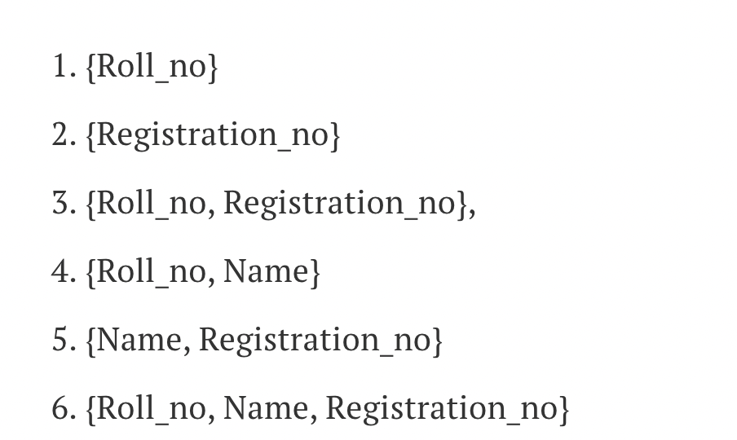
Keys
A superkey is a set of one or more attributes that, taken collectively, allow us to identify uniquely a tuple in the relation.
Formally, let R denote the set of attributes in the schema of relation r. If we say that a subset K of R is a superkey for r, we are restricting consideration to instances of relations r in which no two distinct tuples have the same values on all attributes in K. That is, if t1 and t2 are in r and t1≠t2, then t1.K≠tt2.K.
Super Keys
Minimal superkeys are called candidate keys.
It is possible that several distinct sets of attributes could serve as a candidate Key. Candidate Key is proper subset of Super Key. All candidate Key is a super key but not vice versa.
primary key to denotes a candidate key that is chosen by the database designer as the principal means of identifying tuples within a relation. A key (whether primary, candidate, or super) is a property of the entire relation, rather than of the individual tuples.

Slide 19
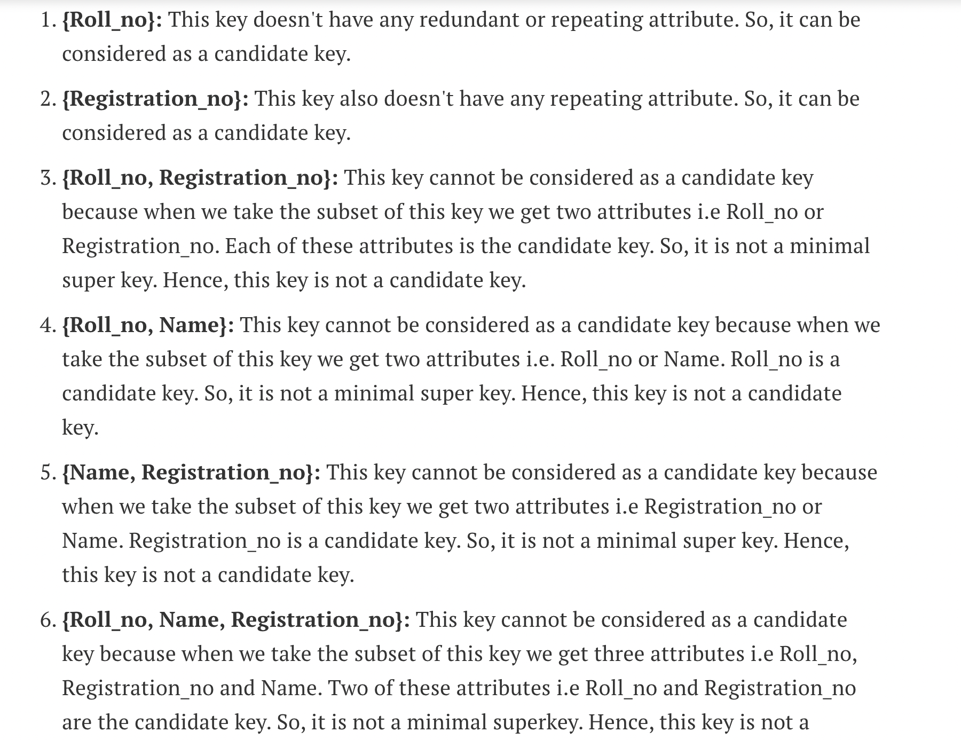
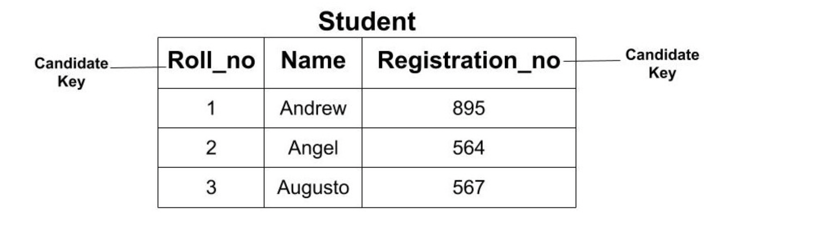
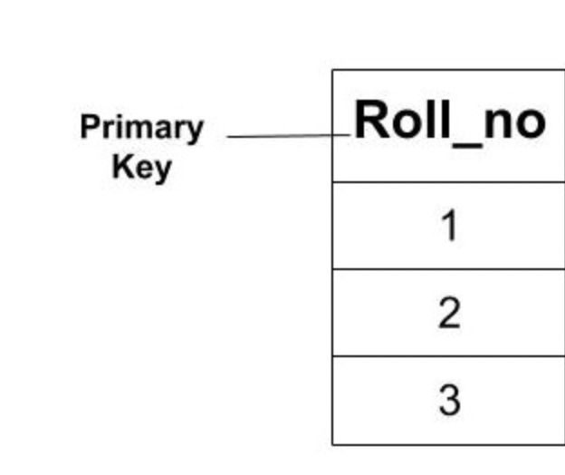
Candidate Key

Slide 20
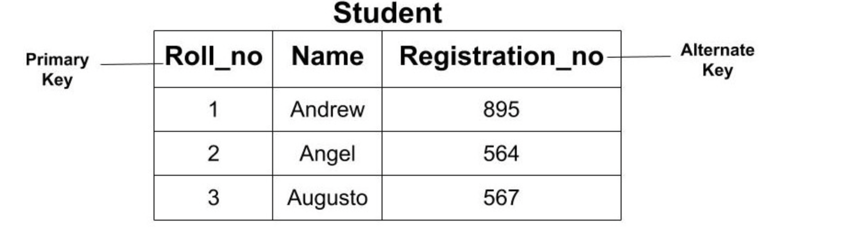
All the candidate key which are not a primary key are called an alternate key.

Slide 21
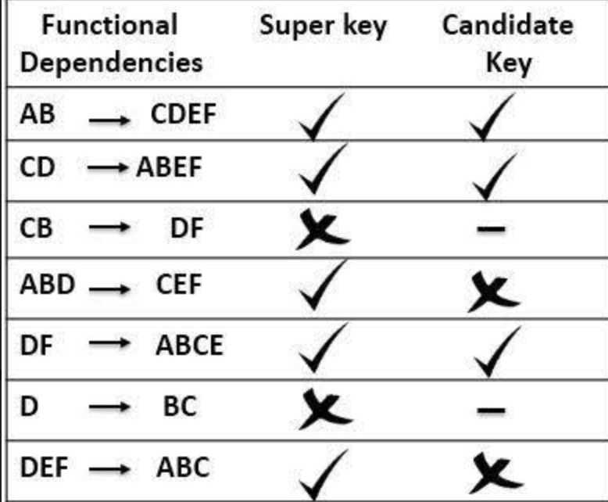

Slide 22
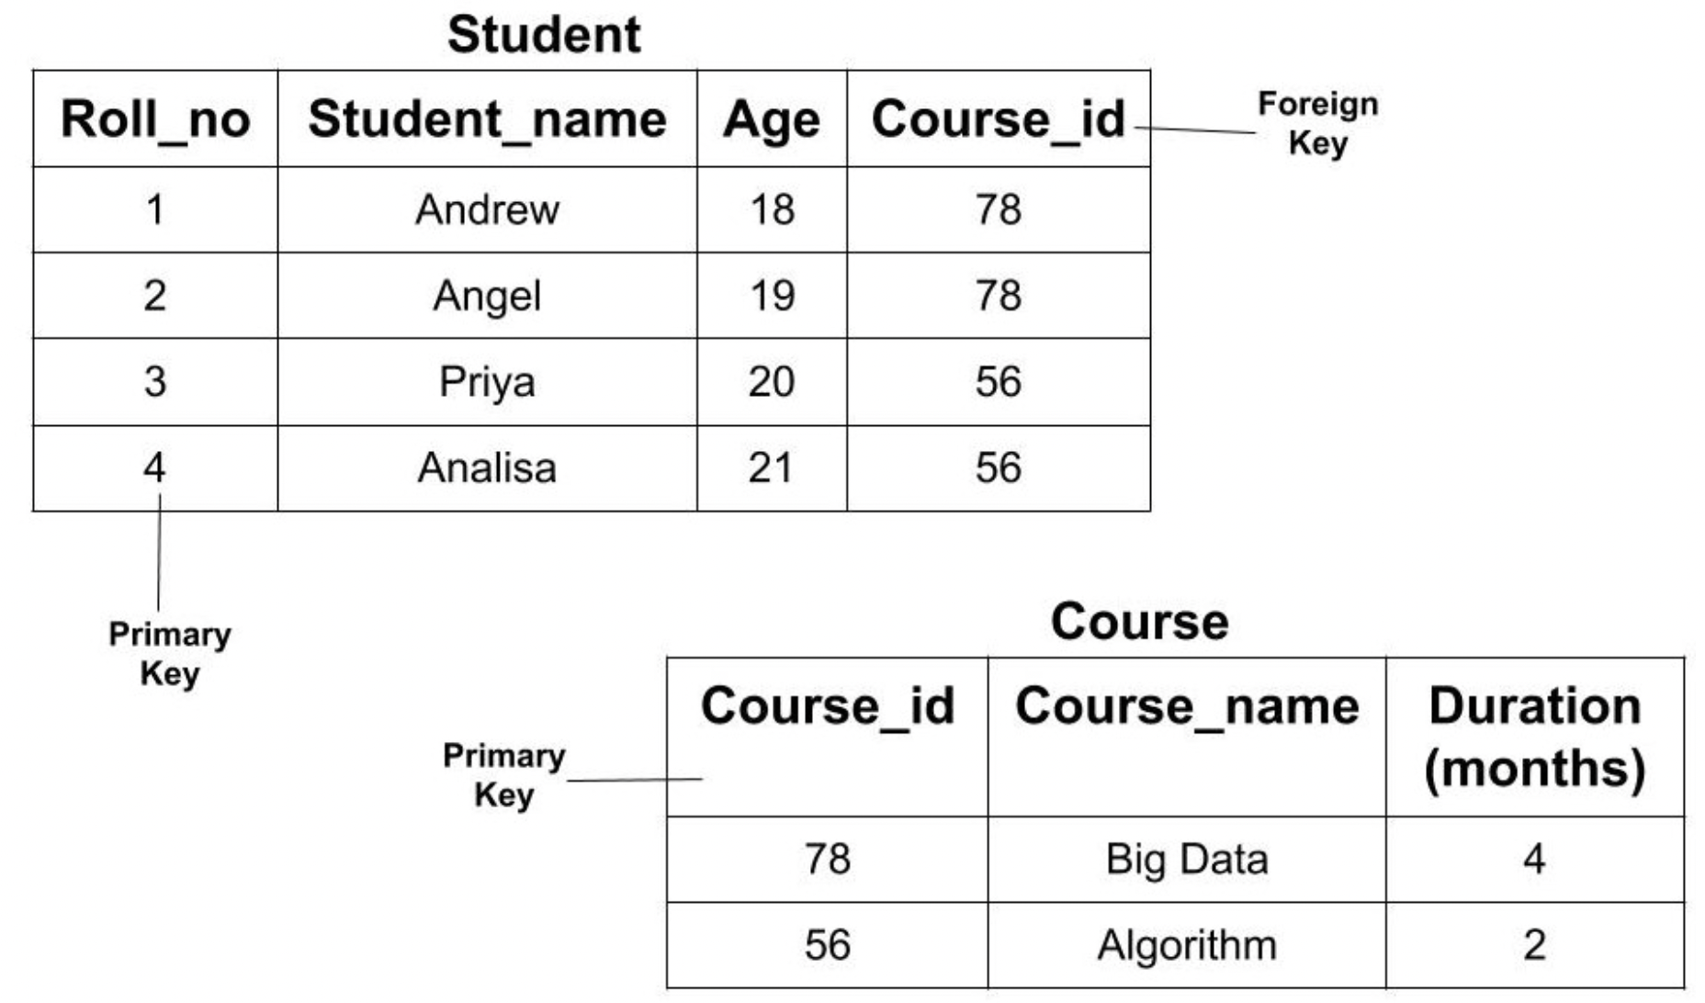
Foreign key
A relation, say r1, may include among its attributes the primary key of an- other relation, say r2. This attribute is called a foreign key from r1, referencing r2.
The relation r1 is also called the referencing relation of the foreign key dependency, and r2 is called the referenced relation of the foreign key.
Referencing relation
Referenced relation

Slide 23
01/06/2021
Relational Query Languages
A query language is a language in which a user requests information from the database. These languages are usually on a level higher than that of a standard programming language. Query languages can be categorized as either procedural or non-procedural.
In a procedural language, the user instructs the system to perform a sequence of operations on the database to compute the desired result. In a nonprocedural language, the user describes the desired information without giving a specific procedure for obtaining that information.
Relational Algebra
The relational algebra consists of a set of operations that take one or two relations as input and produce a new relation as their result. The relational calculus uses predicate logic to define the result desired without giving any specific algebraic procedure for obtaining that result.

Slide 24
RELATIONAL ALGEBRA

Slide 25
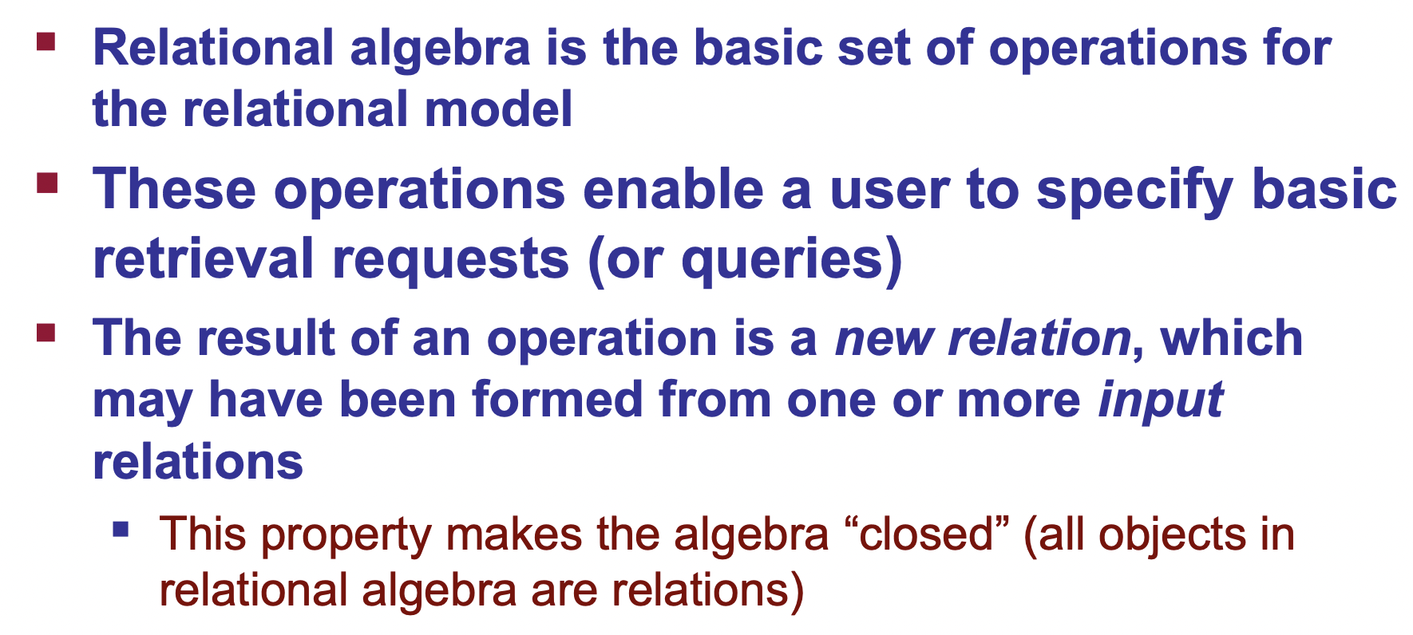

Slide 26
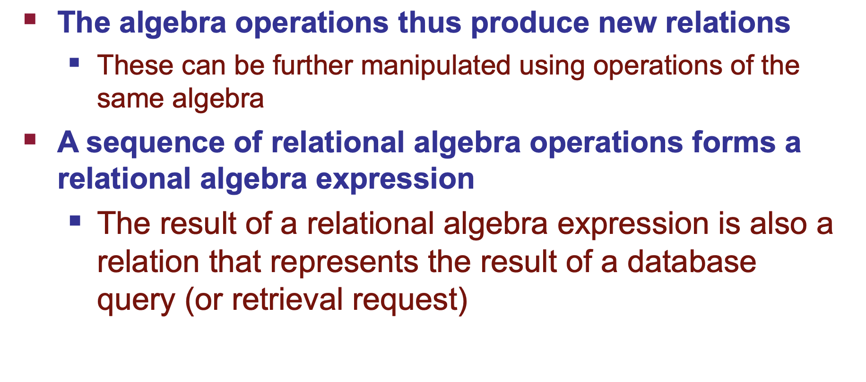

Slide 27
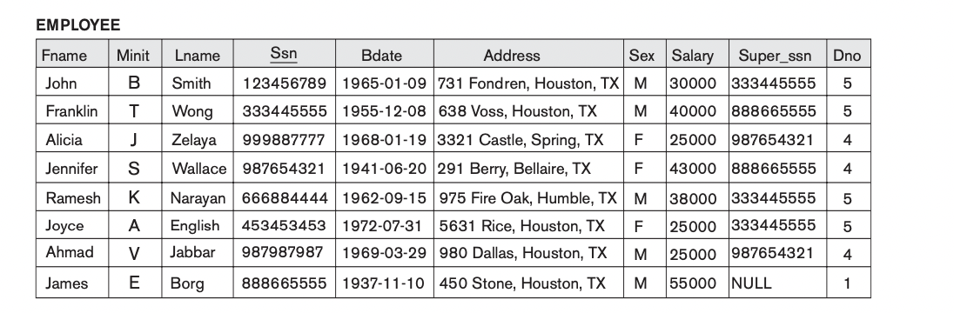
Relational Algebra
Basic Set oprn:
{1,2,3}=A
{1,2,5,6}= B
A and B = {1, 2}
A or B = {1,2,3,5,6}
A -B ={3}
B-A = {5,6}

Slide 28
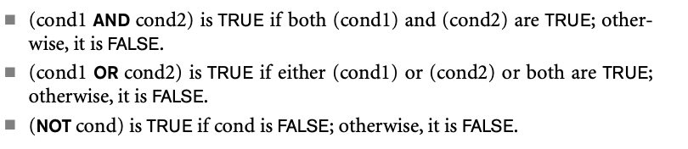

Slide 29
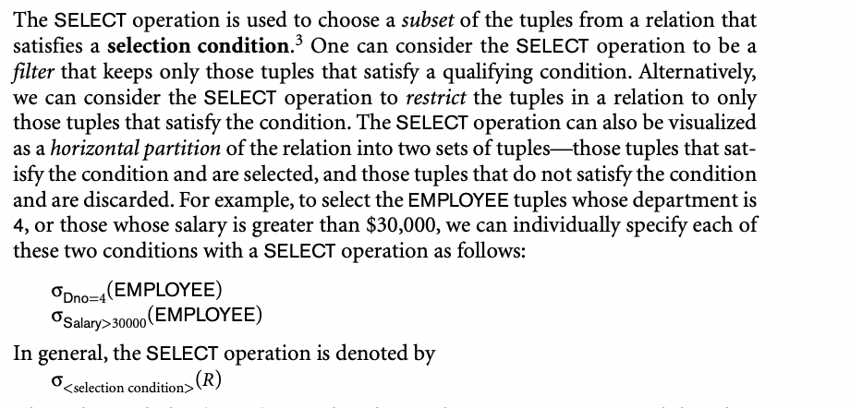
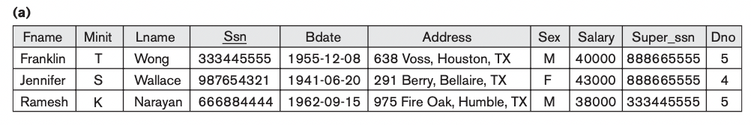
Select operation

Slide 30
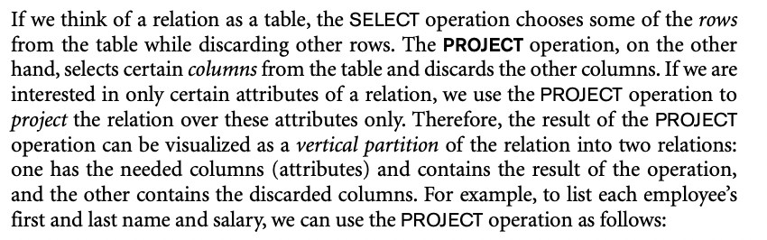
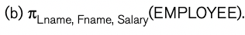
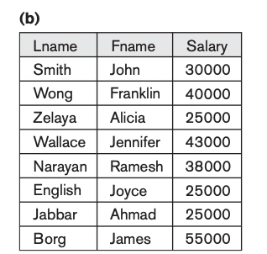
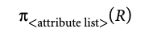
Project Operation

Slide 31
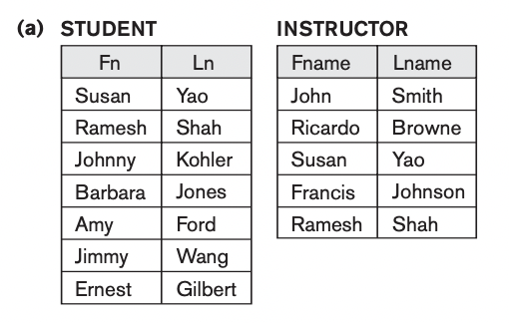

Slide 32
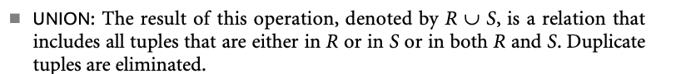
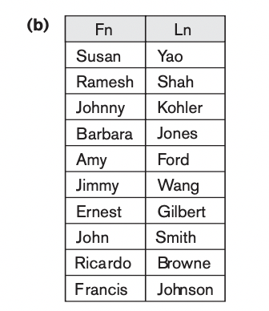
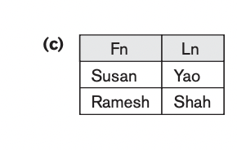
SET Operations
b: STUDENT ⋃ INSTRUCTOR
Student ∩ Instructor

Slide 33
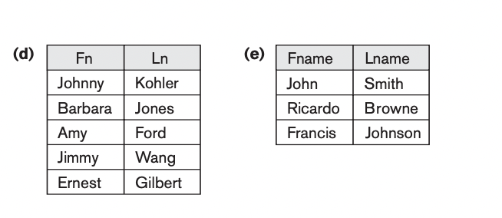
Contd
(d) STUDENT − INSTRUCTOR. (e) INSTRUCTOR − STUDENT.

Slide 34
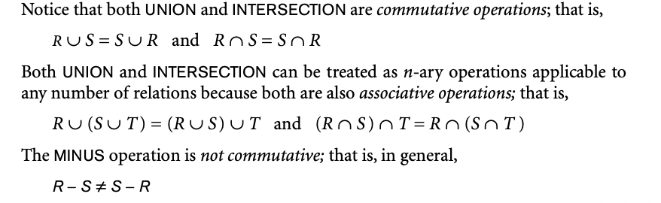
Note:

Slide 35
Rename Operation
02/06/2021
Employee
Renaming Employee to workers
ρ_{workers}(Employee)
Renaming Relation name & Attributes
ρworkers(worker_name, work_dept, worker)(Employee)
Renaming Attributes
ρ(worker_name, work_dept, worker)(Employee)
We can also define a formal RENAME operation—which can rename either the relation name or the attribute names, or both—as a unary operator. The general RENAME operation when applied to a relation R of degree n is denoted by any of the following three forms:
ρS(B1, B2, ..., Bn)(R) or ρS(R) or ρ(B1, B2, ..., Bn)(R)
Sequence of Operation to rename/ Assignment Operator
DEP5_EMPS ← σ_{Dno=5}(EMPLOYEE)
RESULT ← π_{Fname, Lname, Salary}(DEP5_EMPS)

Slide 36
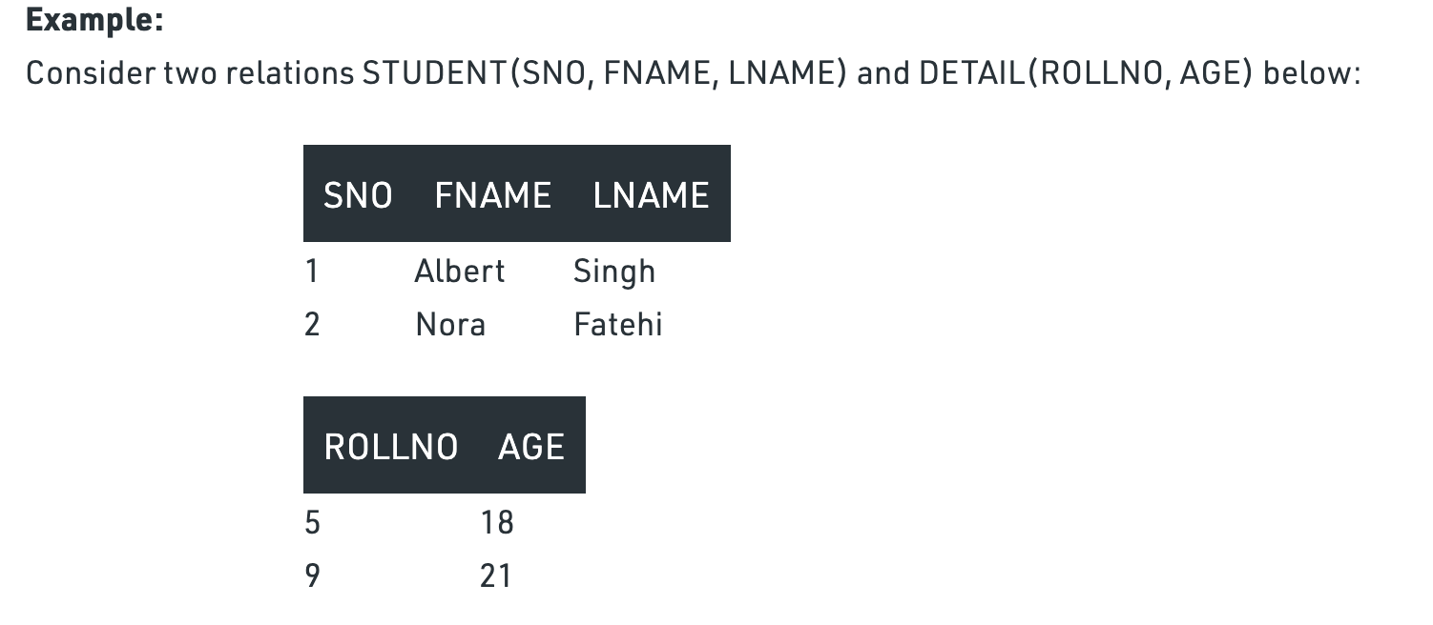
Cartesian Product:
Let A = {H, T} and B = {1, 2, 3, 4, 5, 6}.
A × B = {(H, 1), (H, 2), (H, 3), (H, 4), (H, 5), (H, 6), (T, 1), (T, 2), (T, 3), (T, 4), (T, 5), (T, 6)}
B × A = {(1, H), (2, H), (3, H), (4, H), (5, H), (6, H), (1, T), (2, T), (3, T), (4, T), (5, T), (6, T)}
In Cartesian product , the result of R(A1, A2, ..., An) × S(B1, B2, ..., Bm) is a rela- tion Q with degree n + m attributes Q(A1, A2, ..., An, B1, B2, ..., Bm), in that order. The resulting relation Q has one tuple for each combination of tuples—one from R and one from S. Hence, if R has nR tuples (denoted as |R| = nR), and S has nS tuples, then R × S will have nR * nS tuples.
Student
Detail

Slide 37
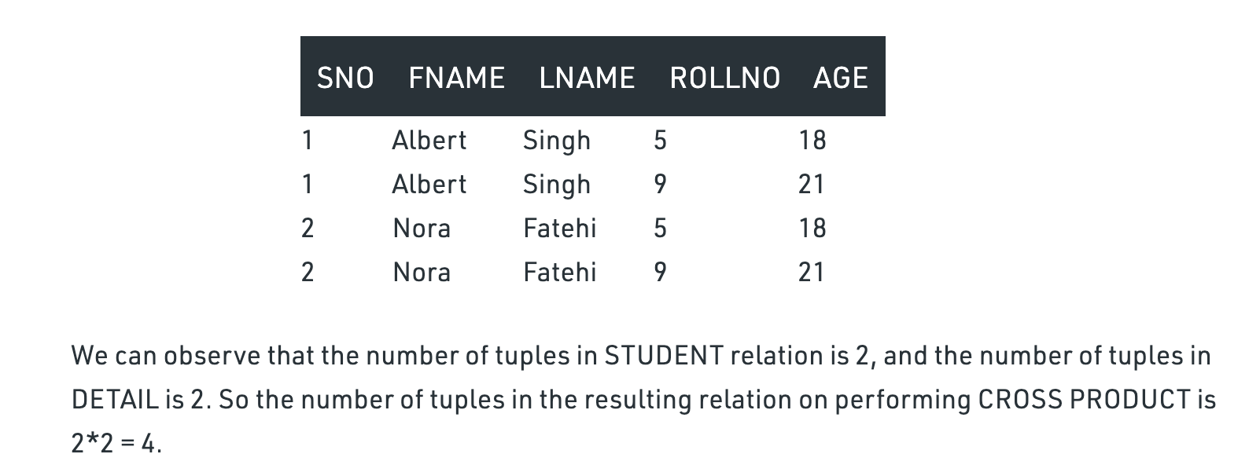
Cardinality = m*n ; m and n are tuples.
Degree = p + s; attributes

Slide 38
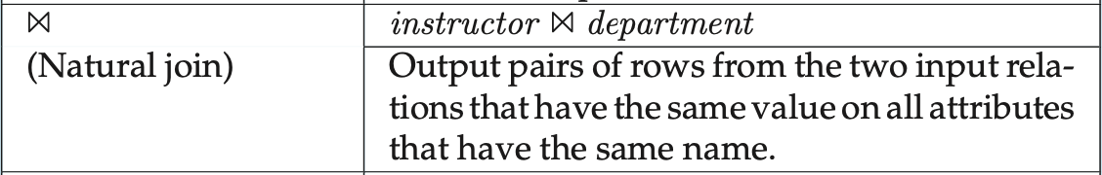
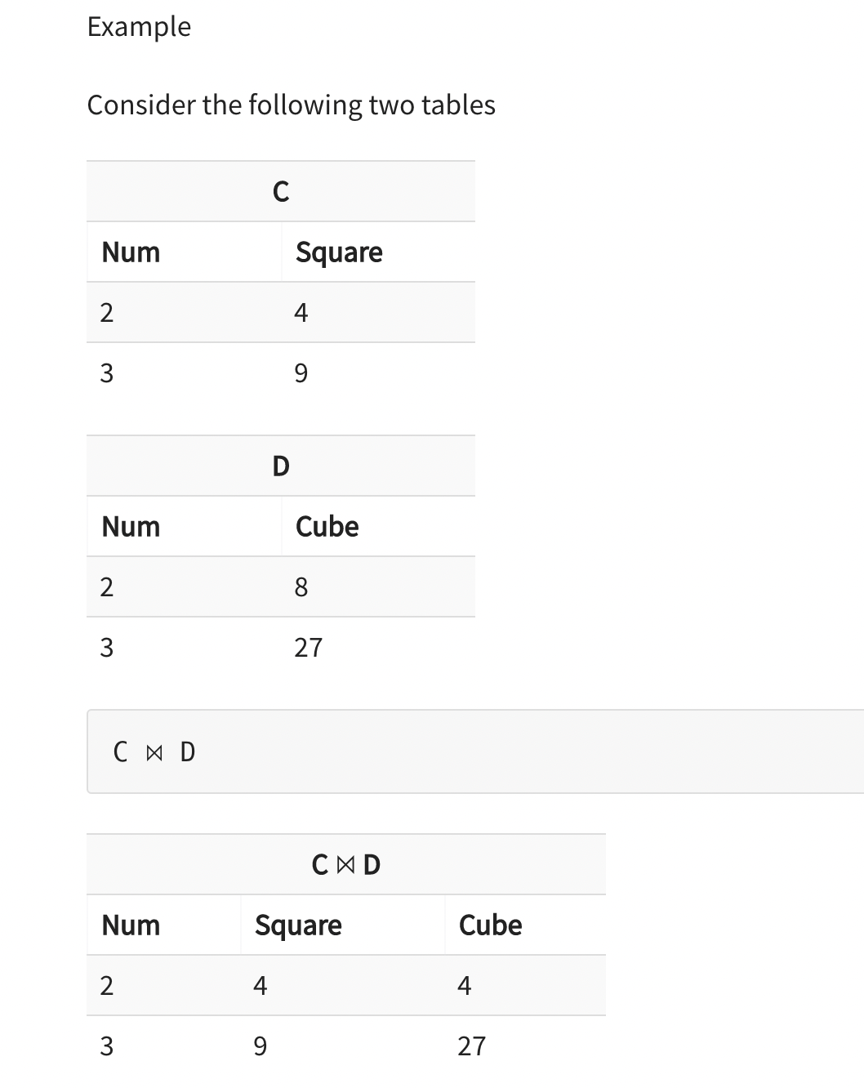
Inner Join
THETA JOIN
The theta join operation NOTATION;
r ⋈_{θ}s
8

Slide 39
PERSON TABLE COURSE TABLE
PSSN Personname dept Cssn course
1 ABC cse 1 DBMS
2 CDE EE 3 ELE
3 EFG EC
RESULT <- PERSON ⋈_{PSSN=CSSN}COURSE --- EQUIJOIN
1 ABC CSE DBMS
3 EFG EC ELE

Slide 40
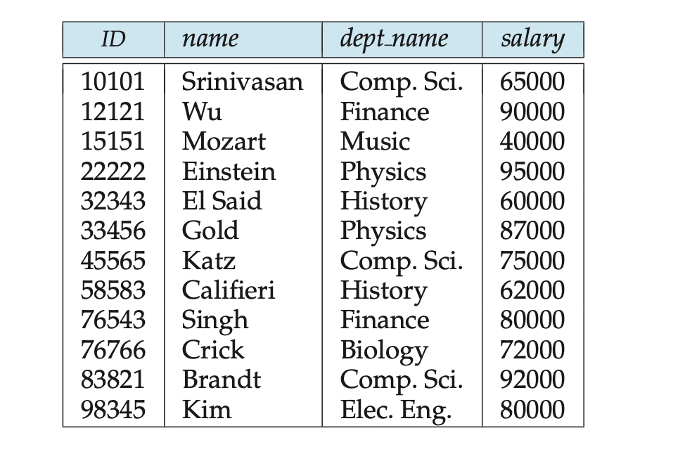
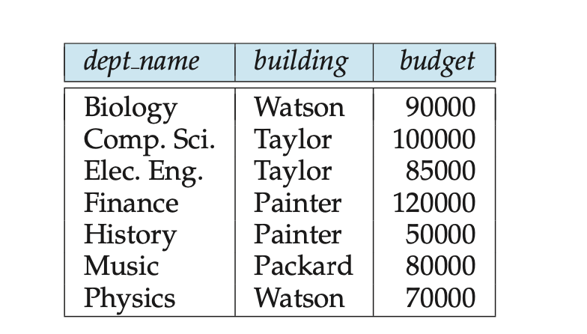
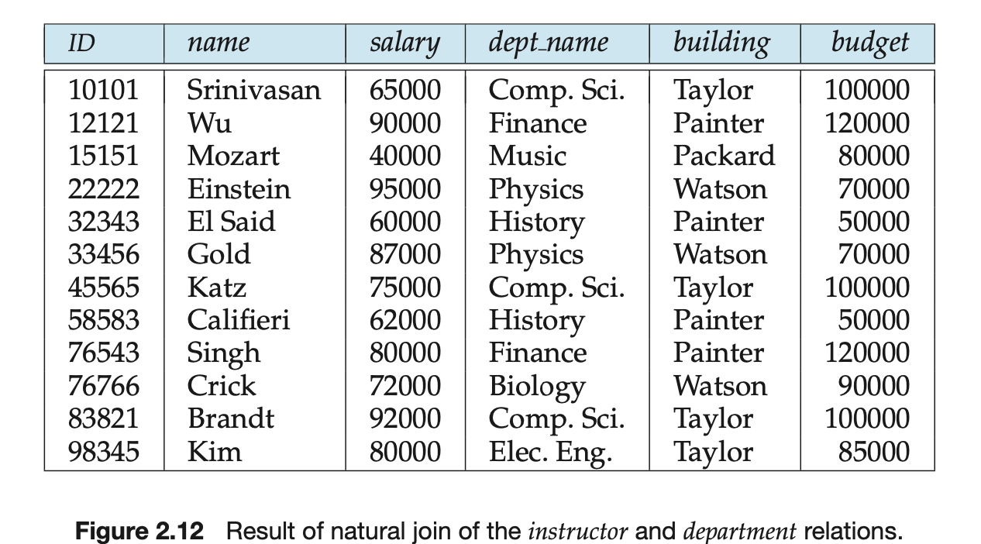

Slide 41
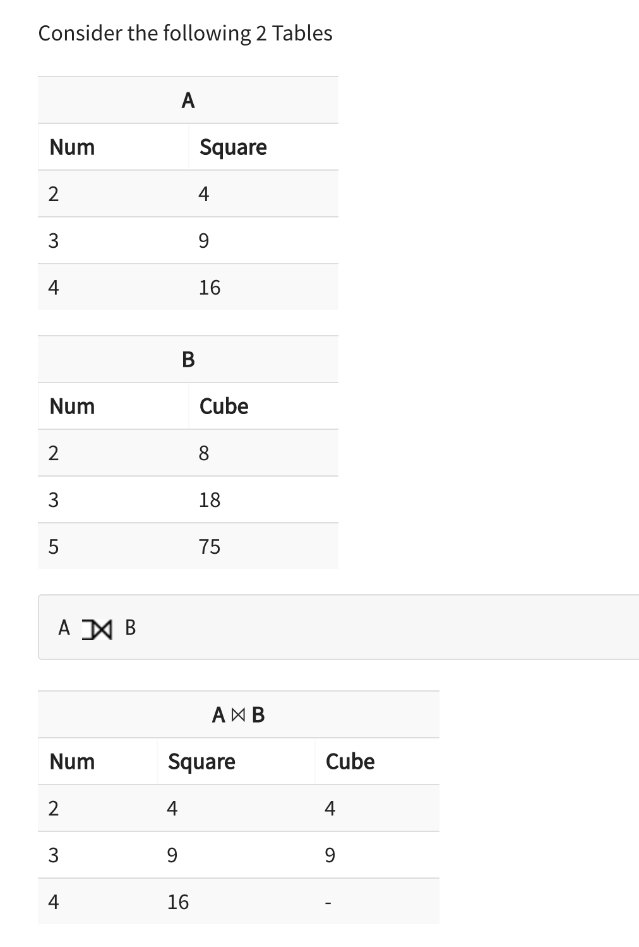
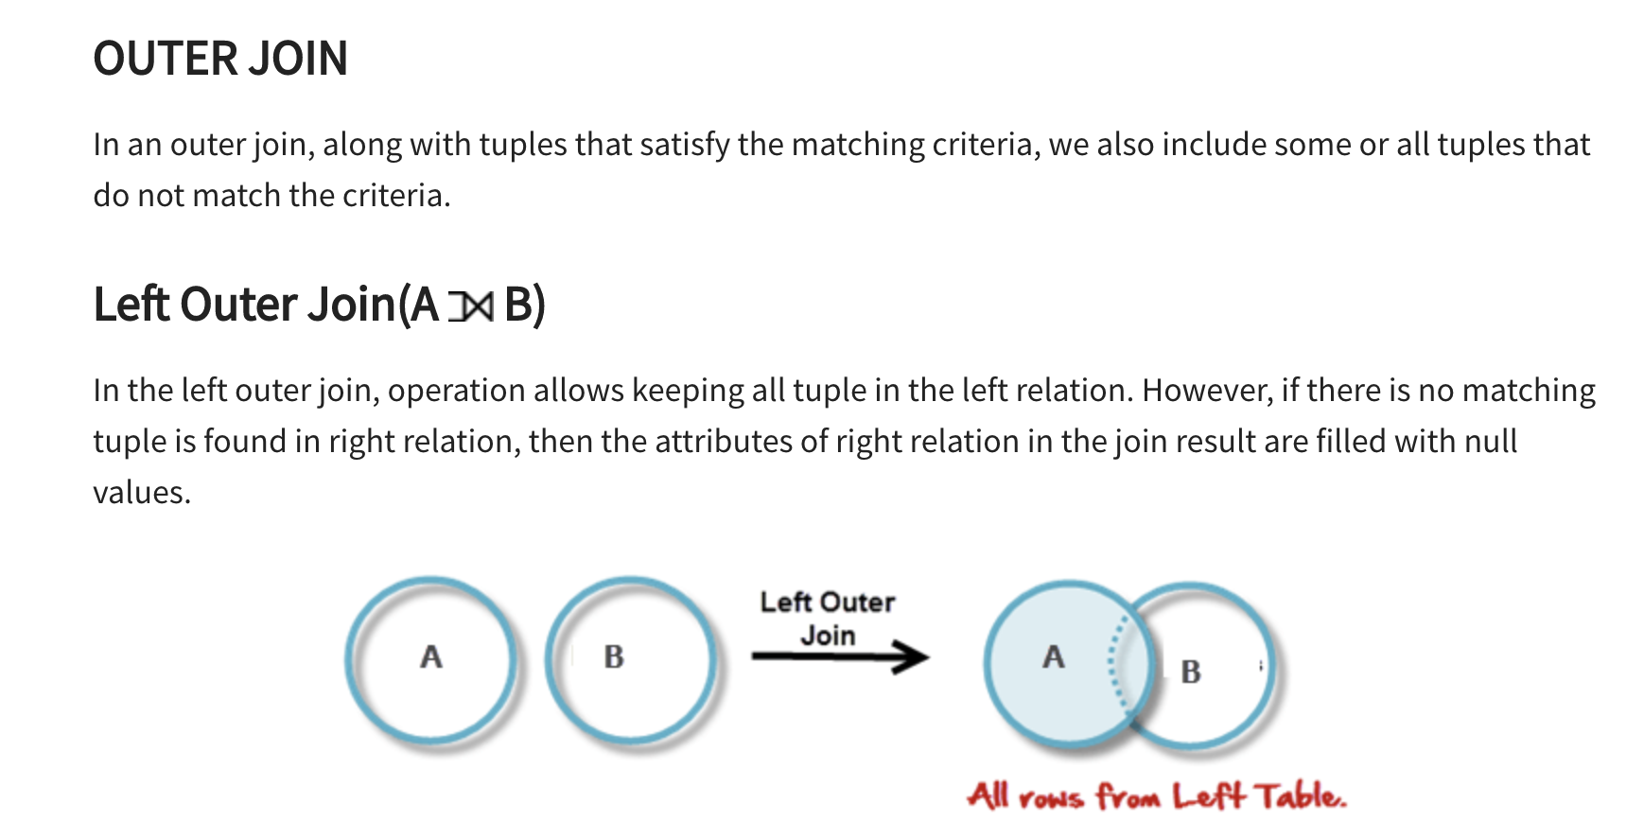
8
18

Slide 42
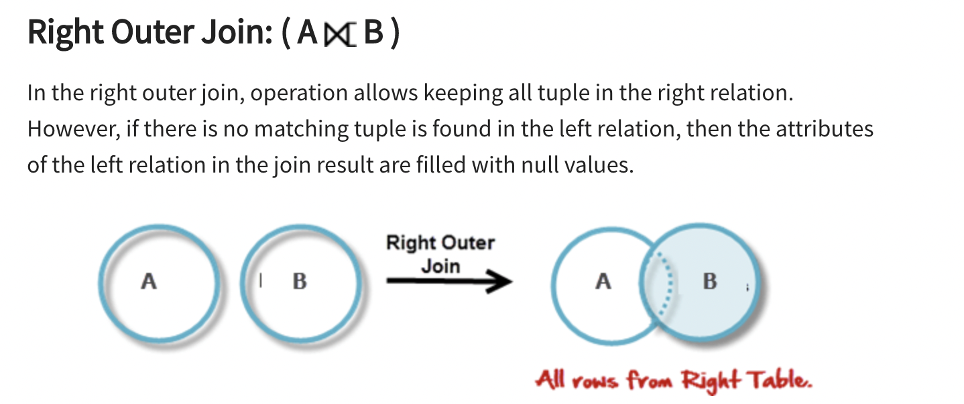
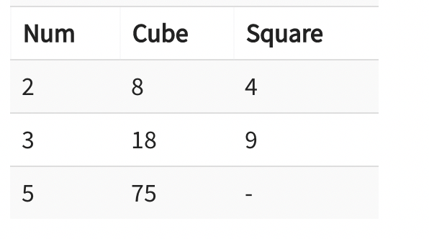
A
B

Slide 43
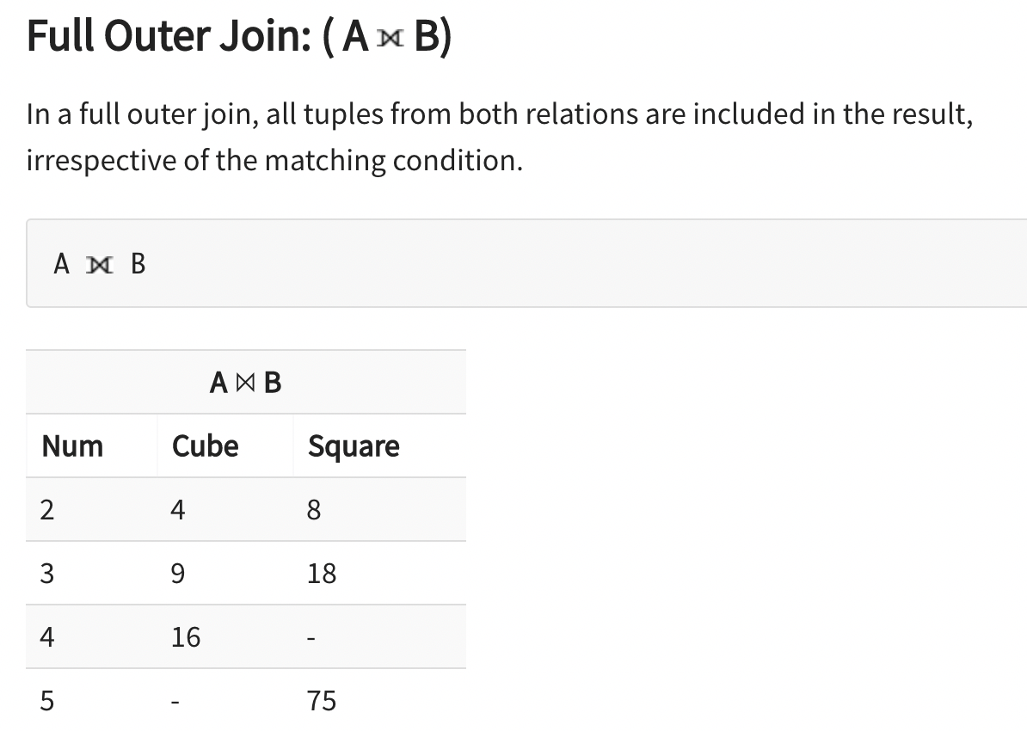

Slide 44
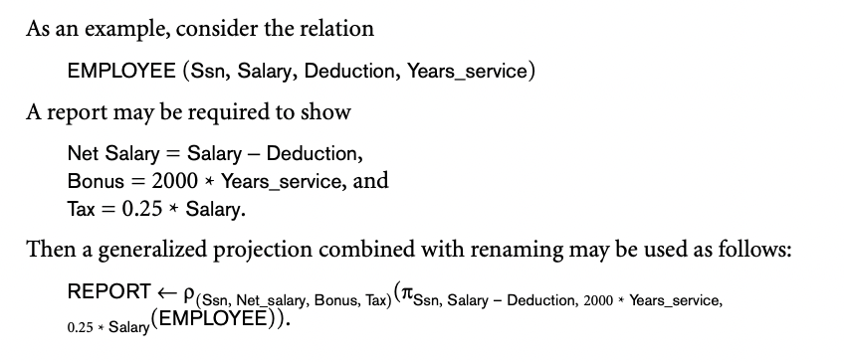
ADDITIONAL OPERATORS 03/06/2021
Generalized-projection operation, which extends the projection operation by allowing operations such as arithmetic and string functions to be used in the projection list. The generalized-projection operation has the form:
The generalized form can be expressed as:
π_{F1, F2, ..., Fn (R)}
Here F1, F2, ..., Fn are functions over the attributes in relation R and may involve arithmetic operations and constant values.

Slide 45

Aggregate Function
Suppose that we want to find out the sum of salaries of all instructors; the relational-algebra expression for this query is:
Aggregate functions take a collection of values and return a single value as a result. For example, the aggregate function sum takes a collection of values and returns the sum of the values. Thus, the function sum applied on the collection:
{1,1,3,4,4,11}
returns the value 24.
The aggregate function avg returns the average of the values. When applied to the preceding collection, it returns the value 4.
The aggregate function count returns the number of the elements in the collection, and returns 6 on the preceding collection.
Other common aggregate functions include min and max, which return the minimum and maximum values in a collection; they return 1 and 11, respectively, on the preceding collection.
The collections on which aggregate functions operate can have multiple occurrences of a value; the order in which the values appear is not relevant. Such collections are called multisets. Sets are a special case of multisets where there is only one copy of each element.

Slide 46
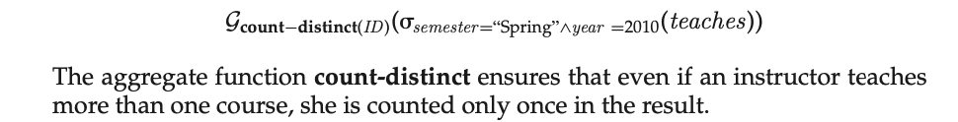
Contd
To eliminate duplicates, → “distinct” appended to the end of the function name (for example, count- distinct).
An example arises in the query “Find the total number of instructors who teach a course in the Spring 2010 semester.” In this case, an instructor counts only once, regardless of the number of course sections that the instructor teaches. The required information is contained in the relation teaches, and we write this query as follows

Slide 47



Contd
Find the average salary in each department.” We write this query as follows:
Yes! Now compute average in each department
First Step -->

Slide 48


CONTRAST EXAMPLE
Consider the query “Find the average salary of all instructors.”
write this query as follows:

Slide 49
Entity Relationships

Slide 50

ER MODEL
05/06/2021
The basic object that the ER model represents is an entity, which is a thing in the real world with an independent existence.
An entity may be an object with a physical existence (for example, a particular person, car, house, or employee) or it may be an object with a conceptual existence (for instance, a company, a job, or a university course).
Each entity has attributes— The particular properties that describe it. For example, an EMPLOYEE entity may be described by the employee’s name, age, address, salary, and job. A particular entity will have a
The entity-relationship (E-R) data model was developed to facilitate database design by allowing specification of an enterprise schema that represents the overall logical structure of a database.
The E-R model is very useful in mapping the meanings and interactions of real-world enterprises onto a conceptual schema.
The EMPLOYEE entity e1 has four attributes: Name, Address, Age, and Home_phone; their values are ‘John Smith,’ ‘2311 Kirby, Houston, Texas 77001’, ‘55’, and ‘713-749-2630’, respectively. The COMPANY entity c1 has three attributes: Name, Headquarters, and President; their values are ‘Sunco Oil’, ‘Houston’, and ‘John Smith’, respectively.

Slide 51

An entity set is a set of entities of the same type that share the same properties, or attributes. The set of all people who are instructors at a given university, for example, can be defined as the entity set instructor. Similarly, the entity set student might represent the set of all students in the university.
An entity is represented by a set of attributes. Attributes are descriptive properties possessed by each member of an entity set.

Slide 52

Attributes
Composite versus Simple (Atomic) Attributes.
Composite attributes can be divided into smaller subparts, which represent more basic attributes with independent meanings. For example, the Address attribute of the EMPLOYEE entity shown in Figure 7.3 can be subdivided into Street_address, City, State, and Zip,3 with the values ‘2311 Kirby’, ‘Houston’, ‘Texas’, and ‘77001.’
Attributes that are not divisible are called simple or atomic attributes. Composite attributes can form a hierarchy; for example, Street_address can be further subdivided into three simple component attributes: Number, Street, and Apartment_number, as shown in Figure 7.4. The value of a composite attribute is the concatenation of the values of its component simple attributes.

Slide 53
Stored V/S Derived attribute:
The value of Age can be determined from the current (today’s) date and the value of that person’s Birth_date. The Age attribute is hence called a derived attribute and is said to be derivable from the Birth_date attribute, which is called a stored attribute. Some attribute values can be derived from related entities; for example, an attribute Number_of_employees of a DEPARTMENT entity can be derived by counting the number of employees related to (working for) that department.
NULL Values.
If Attribute Value does not exist(eg: Degree of person)
If Attribute Value is Missing (Eg: Height of person)
If attribute value is Unknown (Home Phone number
Single-Valued versus Multivalued Attributes.
Most attributes have a single value for a particular entity; such attributes are called single-valued. For example, Age is a single-valued attribute of a person. In some cases an attribute can have a set of values for the same entity—for instance, a Colors attribute for a car, or a College_degrees attribute for a person.
Cars with one color have a single value, whereas two-tone cars have two color values. Similarly, one person may not have a college degree, another person may have one, and a third person may have two or more degrees; therefore, different people can have different numbers of values for the College_degrees attribute. Such attributes are called multivalued.
A multivalued attribute may have lower and upper bounds to constrain the number of values allowed for each individual entity. For example, the Colors attribute of a car may be restricted to have between one and three values, if we assume that a car can have three colors at most.

Slide 54
Complex Attributes.
Attributes that are composite and multivalued attributes can be nested arbitrarily.
We can represent arbitrary nesting by grouping components of a composite attribute between parentheses () and separating the components with commas, and by displaying multivalued attributes between braces { }.
Such attributes are called complex attributes. For example, if a person can have more than one residence and each residence can have a single address and multiple phones, an attribute Address_phone for a person can be specified as shown below. Both Phone and Address are themselves composite attributes.
{Address_phone( {Phone(Area_code,Phone_number)},Address(Street_address (Number,Street,Apartment_number),City,State,Zip) )}

Slide 55


Key Attributes
Key Attributes of an Entity Type. An important constraint on the entities of an entity type is the key or uniqueness constraint on attributes. An entity type usually has one or more attributes whose values are distinct for each individual entity in the entity set. Such an attribute is called a key attribute, and its values can be used to identify each entity uniquely.
In ER diagram Keys are Underlined

Slide 56


Advices

Slide 57

07/06/2021

Slide 58

Role of Entity in Relationship
The function that an entity plays in a relationship is called that entity’s role.
Recursive Role:
Same entity set participates in a relationship set more than once, in different roles. In this type of relationship set, recursive relationship set, explicit role names are necessary to specify how an entity participates in a relationship instance.

Slide 59

Descriptive Attribute in Relation
A relationship may also have attributes called descriptive attributes. Consider a relationship set advisor with entity sets instructor and student. We could associate the attribute date with that relationship to specify the date when an instructor became the advisor of a student. The advisor relationship among the entities corresponding to instructor Katz and student Shankar has the value “10 June 2007” for attribute date, which means that Katz became Shankar’s advisor on 10 June 2007.

Slide 60


an instructor may advise many students, and a student may have many advisors.

Slide 61

Participation Constraints and Existence Dependencies
The participation constraint specifies whether the existence of an entity depends on its being related to another entity via the relationship type. This constraint specifies the minimum number of relationship instances that each entity can participate in, and is some- times called the minimum cardinality constraint. There are two types of participation constraints—total and partial—that we illustrate by example. I
If a company policy states that every employee must work for a department, then an employee entity can exist only if it participates in at least one WORKS_FOR relationship instance (Figure 7.9). Thus, the participation of EMPLOYEE in WORKS_FOR is called total participation, meaning that every entity in the total set of employee entities must be related to a department entity via WORKS_FOR. Total participation is also called existence dependency.

Slide 62

We do not expect every employee to manage a department, so the participation of EMPLOYEE in the MANAGES relationship type is partial, meaning that some or part of the set of employee entities are related to some department entity via MANAGES, but not necessarily all.
In ER diagrams, total participation (or existence dependency) is displayed as a double line connecting the participating entity type to the relationship, whereas partial participation is represented by a single line

Slide 63
Weak Entity Set
An entity set that has a primary key is termed a strong entity set.
An entity set that does not have sufficient attributes to form a primary key is termed a weak entity set.
For a weak entity set to be meaningful, it must be associated with another entity set, called the identifying or owner entity set.
Every weak entity must be associated with an identifying entity; that is, the weak entity set is said to be existence dependent on the identifying entity set. The identifying entity set is said to own the weak entity set that it identifies.
The relationship associating the weak entity set with the identifying entity set is called the identifying relationship.
The identifying relationship is many-to-one from the weak entity set to the identifying entity set, and the participation of the weak entity set in the relationship is total. The identifying relationship set should not have any descriptive attributes, since any such attributes can instead be associated with the weak entity set.

Slide 64

Although a weak entity set does not have a primary key, we nevertheless need a means of distinguishing among all those entities in the weak entity set that depend on one particular strong entity.
The discriminator of a weak entity set is a set of attributes that allows this distinction to be made. For example, the discriminator of the weak entity set section consists of the attributes secand semester, since, for each course, this set of attributes uniquely identifies one single section for that course.
The discriminator of a weak entity set is also called the partial key of the entity set.

Slide 65


Slide 66


Recursive

Slide 67

Extended ER diagram
09/06/2021
Super Class and Sub Class
“IS A” Relationship
Specialisation - Top Down Approach
Generalisation - Bottom -up Approach

Slide 68

Specialisation
College
Employee --?
Permanent Emp : XYZ
{Disjoint set}
Temporary emp: XYZ
Overlapping
Disjoint
Generalisation

Slide 69


Slide 70

D or disjoint

Slide 71


Slide 72


Slide 73


Slide 74

Aggregation
10/06/2021
Suppose that each instructor guiding a student on a project is required to file a monthly evaluation report.
We model the evaluation report as an entity evaluation, with a primary key evaluation id.
One alternative for recording the (student, project, instructor) combination to which an evaluation corresponds is to create a quaternary (4-way) relationship set eval for between instructor, student, project, and evaluation. (A quaternary relationship is required — a binary relationship between student and evaluation, for example, would not permit us to represent the (project, instructor) combination to which an evaluation corresponds.)
Using the basic E-R modeling constructs, we obtain the E-R diagram

Slide 75

Aggregation is an abstraction through which relationships are treated as higher-level entities.
Thus, for our example, we regard the relationship set proj guide (relating the entity sets instructor, student, and project) as a higher-level entity set called proj_guide.
Such an entity is treated in the same manner as is any other entity set.
We can then create a binary relationship eval for between proj _guide and evaluation to represent which (student, project, instructor) combination an evaluation is for. Figure shows a notation for aggregation commonly used to represent this situation.

